Slide 1
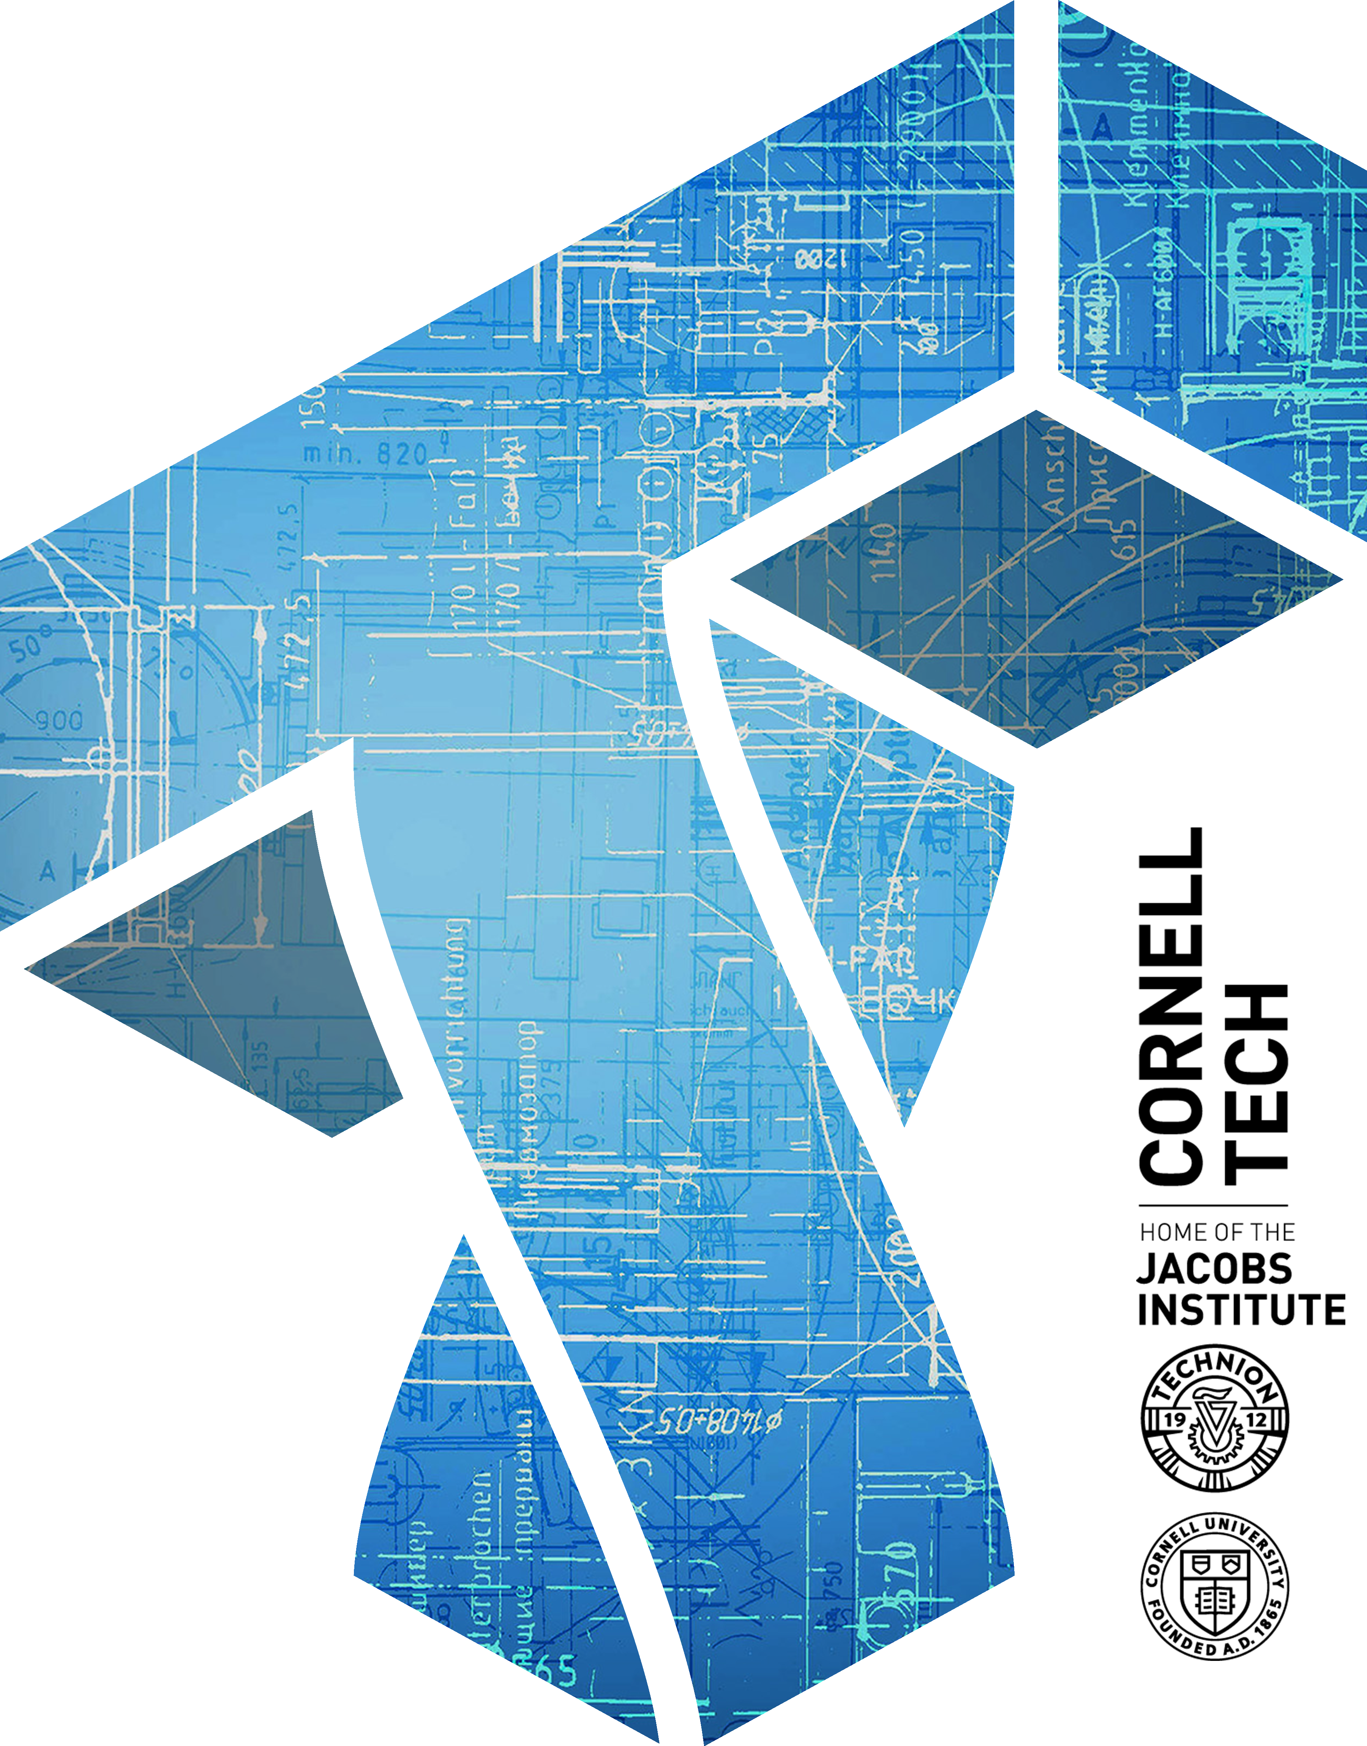

CS 6831 Designing Secure Cryptography
Tom Ristenpart

Slide 2
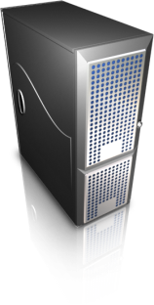
Schnorr ID scheme and signatures
R
r <-$ Z_{q}
R = g^{r}
c <-$ Z_{q}
c
Prover
Verifier
Knows sk = x
Knows pk = X = g^{x}
z = cx+r
If RX^{c} = g^{z} then Ret 1
Else Ret 0
Signature is commitment and response. Challenge generated non-interactively with RO
Works on other Sigma protocols as well
Sign(x, M )
r <-$ Z_{q}
R = g^{r} ; c = H(M || R) ; z = r + cx mod q
Return (R,z)
Ver(X, M, (R,z) )
c = H(M || R)
If g^{z} = RX^{c} then Return 1
Return 0

Slide 3
Analysis summary
Formalize ID protocols and their security under passive attacks
Prove Schnorr ID protocol secure
Requires so-called rewinding lemma
Run an adversary twice on related randomness, likely to succeed twice
Uses fact that Schnorr protocol is honest-verifier zero-knowledge
Prove that Schnorr signature UF-CMA implied by Schnorr ID passive attack security

Slide 4
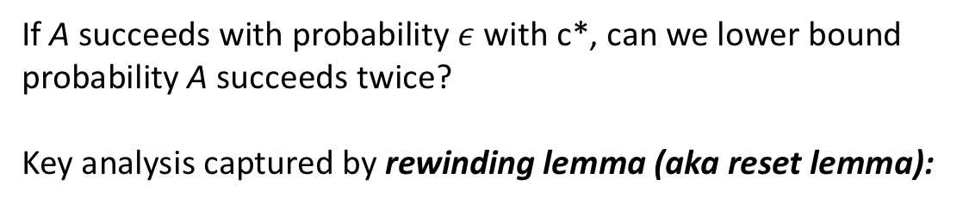
Reduction from IDPASS to DL
If A succeeds with probability $ε$ with c*, can we lower bound probability A succeeds twice?
Key analysis captured by rewinding lemma (aka reset lemma):
Notes:
For Schnorr:
RX^{c} = g^{z-cx} g^{xc} = g^{z}

Slide 5
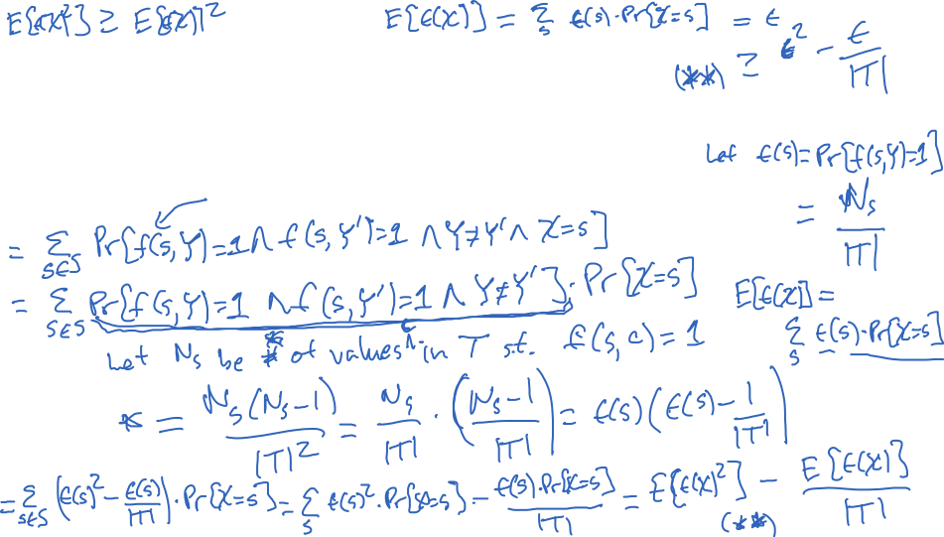

Proof of rewinding lemma
Notes:
For Schnorr:
RX^{c} = g^{z-cx} g^{xc} = g^{z}

Slide 6
Putting it all together: UF-CMA to DL

Slide 7

Digital signature schemes
Scheme | Problems? | Analyses? | Uses
RSA PKCS#1 v1.5 | Bleichanbacher attacks |  | TLS, Certificates, XML
RSA PSS (PKCS#1 v2) |  | Security reduces to hardness of inverting RSA
Schnorr (ECC or Z_{q} ) | Randomness fragility | Security reduces to discrete log problem
DSA (ECC or Z_{q} ) | Randomness fragility | No security reduction | Bitcoin (ECC version), TLS, SSH, elsewhere
*
*

Slide 8
TLS handshake for Diffie-Hellman Key Exchange
Client
Server
ClientHello, MaxVer, Nc, Ciphers/CompMethods
Pick random Nc
Check CERT
using CA public
verification key
Check σ
ServerHello, Ver, Ns, SessionID, Cipher/CompMethod
Pick random Ns
CERT = (pk_{s} , signature over it)
Pick random x
X = g^{x}
p , g , X , σ = Sign(sk_{s}, Nc||Ns||p||g||X)
Pick random y
Y = g^{y}
Y
PMS = g^{xy}
ChangeCipherSpec,
{ Finished, PRF(MS, “Client finished” || H(transcript)) }
PMS = g^{xy}
ChangeCipherSpec,
{ Finished, PRF(MS, “Server finished” || H(transcript’)) }
MS <- PRF(PMS, “master secret” || Nc || Ns )

Slide 9



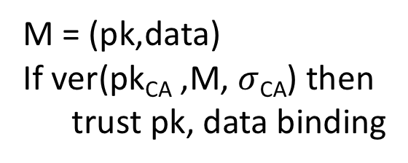
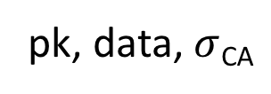
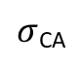
Certificate Authorities and Public-key Infrastructure
(pk,sk)
Give me a certificate
for pk, data please
pk_{CA}
M = (pk,data)
S = sign(sk_{CA},M)
$σ$_{CA}
http://amazon.com
pk, data, $σ$_{CA}
M = (pk,data)
If ver(pk_{CA} ,M, $σ$_{CA}) then
trust pk, data binding
(pk,sk)
This prevents man-in-the-middle (MitM) attacks

Slide 10
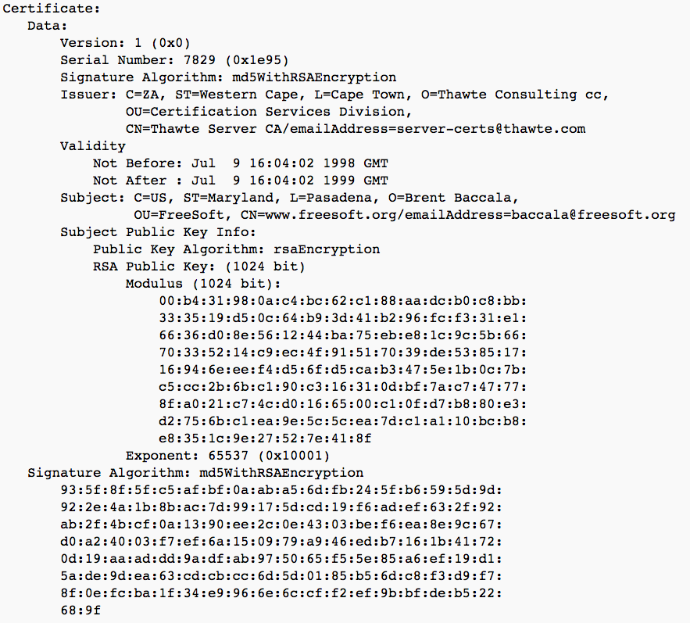

Slide 11
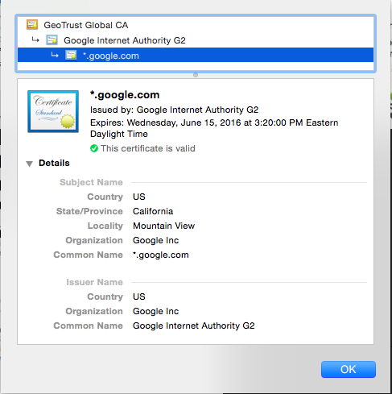
Certificate chains

Slide 12
Identity checks?
CA’s must check that requestor of cert is who they say they are
Domain validated
Prove ownership of domain
Extended validation
Establish legal identity of requestor
Physical presence of website owner
Confirm ownership of domain
Etc.

Slide 13
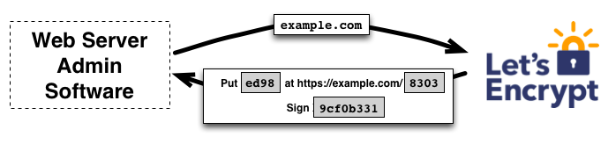
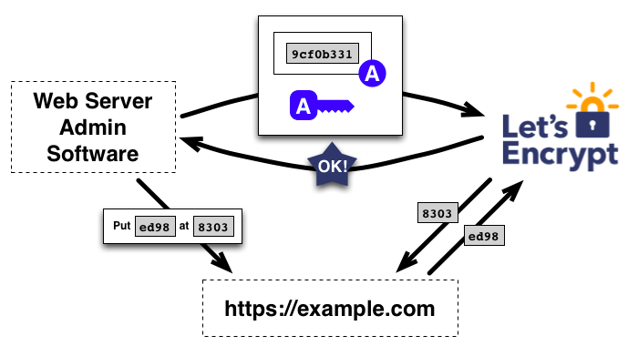
Free CAs

Slide 14
The Web PKI Ecosystem
http://conferences.sigcomm.org/imc/2013/papers/imc257-durumericAemb.pdf
~1800 CAs that can sign any domain controlled by 683 organizations

Slide 15
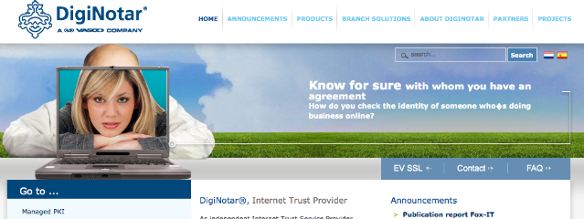
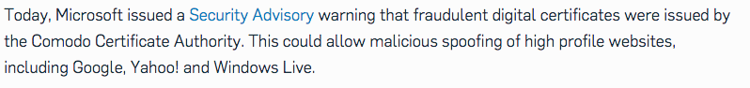
https://nakedsecurity.sophos.com/2011/03/24/fraudulent-certificates-issued-by-comodo-is-it-time-to-rethink-who-we-trust/
https://technet.microsoft.com/library/security/2524375

Slide 16
Turktrust incident
Turktrust is a CA used by Turkish government
December, 2012 detected an erroneous CERT for *.google.com signed by Turktrust
Gives whoever owned private key ability to MITM most Google websites

Slide 17
Certificate/public-key pinning
Client knows what cert/pk to expect, rejects otherwise
Pre-install some keys
HPKP (HTTP Public Key Pinning)
HTTP header that allows servers to set a hash of public key they will use
Public-Key-Pins:
pin-sha256="d6qzRu9zOECb90Uez27xWltNsj0e1Md7GkYYkVoZWmM=";
pin-sha256="LPJNul+wow4m6DsqxbninhsWHlwfp0JecwQzYpOLmCQ=";
max-age=259200
https://developers.google.com/web/updates/2015/09/HPKP-reporting-with-chrome-46?hl=en

Slide 18
Certificate transparency
Force CAs to log the certificates they sign in a public tamper-evident register
Experimental IETF standard
Google promoted this approach
Chrome requires it for “extra validation” certs
DigiCert has implemented

Slide 19
Revocation
Certificates must often be revoked
Short expirations
CRLs (Certificate revocation lists)
OCSP (online certificate status protocol)
Client queries CA to check on validity of cert
privacy concerns, performance / scalability issues
Stapling: server periodically gets fresh, time-stamped OCSP signature from CA. Sends to clients, avoiding need for client to perform OCSP lookup
Liu et al. 2015:
8% of certs on internet revoked
Most browsers don’t properly check for revocation
Mobile browsers never do…
http://www.ccs.neu.edu/home/cbw/static/pdf/liu-imc15.pdf

Slide 20
Measurement studies of TLS ecosystem
Use internet-wide scanning to measure ecosystem
Zmap is state-of-art tool:
scan one port of entire Internet in ~45 minutes
Was extended to perform TLS handshakes with servers that are open on port 443
Fewer than 2³² IP addresses: ~3,706,452,992
Exclude private addresses (e.g., 192.168.0.0/16),
multicast addresses, ...

Slide 21
Some HTTPS scans
2011 scan (Heninger et al.)
12,828,613 certificate chains recovered
5,656,519 distinct RSA public keys
6,241 distinct DSA public keys
Found many factorable RSA keys, DSA keys signing with repeat randomness
2013 scan (Durumeric et al.)
Almost all CA’s using RSA keys for signing certs
~8 million unique certificates across ~30 million hosts

Slide 22
Weak RSA keys
Recall: (pk,sk) = ((N,e),(N,d)) for N = pq
Repeat keys (may or may not be problem)
Factoring is hard for large key sizes (>=1024)
But: bad randomness causes bad p,q generation
Ex: N1 = p * q N2 = p * q’
Compute GCD of large integers in milliseconds
Use Bernstein’s all-pairs GCD to scale up
[Heninger et al. 2012]

Slide 23
RNGs and RSA key generation
p
q
Both primes the same
t t+1
p
q
Both primes different
t t+1
p
q
Shared prime
t t+1

Slide 24
Weak keys
From [Heninger et al. 2012]
Pre-ZMap: Used 25 EC2 servers to scan IPv4
W/ ZMap: completes much faster and cheaper

Slide 25
2013 scan: breakdown by CA

Slide 26
2013 scan: 1024-bit RSA CA keys

Slide 27
Scanning now a widely used tool to evaluate crypto empirically
DROWN attacks (Bleichanbacher downgrade against SSLv2):
30% of TLS servers on IPv4 are vulnerable
Dual EC fingerprinting
Found 720 servers using BSAFE-Java
LogJam attacks (Downgrade to export-level crypto in TLS)
7% of Alexa Top Million
Many further measurement studies: TLS CA ecosystem, SMTP server ecosystem, SCADA control systems, FTP servers, …

Slide 28
What’s next in scanning?
Improvements over Zmap?
Application layer scanning?
IPv6 will cause horizontal scan challenges
Think about methodology, not just results
Zmap paper has had a lot of impact
“Cottage industry” for Zmap authors, but many others also using it

